Slide 1



online shop
Menu
About Us
@reallygreatsite
revolutionizing online shopping
www.onlineshop.com

Slide 2
online shop
Menu
About Us
@reallygreatsite
Content
Registration & Login page
Home view for products
Product detail page
Wishlist and Notification
Profile
Cart and CheckOut

Slide 3
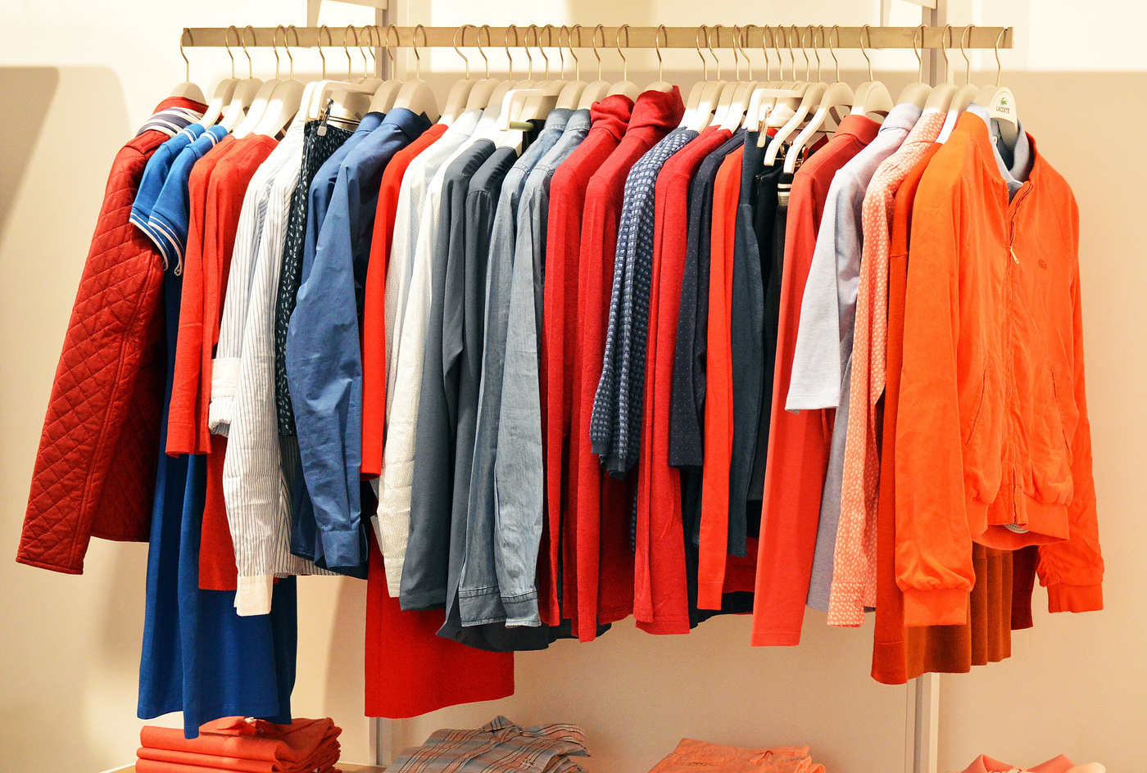

online shop
Menu
About Us
@reallygreatsite
rapidly grown into a leading eCommerce platform
Founded in 2013, Larana, Inc. has rapidly grown into a leading eCommerce platform that connects millions of customers and sellers globally. With a commitment to innovation and excellence, we offer a wide range of products, from fashion and electronics to home essentials and unique artisanal goods. Our platform combines cutting-edge technology with a deep understanding of consumer behavior, enabling us to offer an intuitive and seamless online shopping experience.
We believe in empowering both customers and businesses, ensuring that each transaction is not just a sale but an opportunity to build lasting relationships. Our platform offers sellers advanced analytics, marketing tools, and fulfillment services, allowing them to focus on what they do best — creating great products.
a deep understanding of consumer behavior

Slide 4

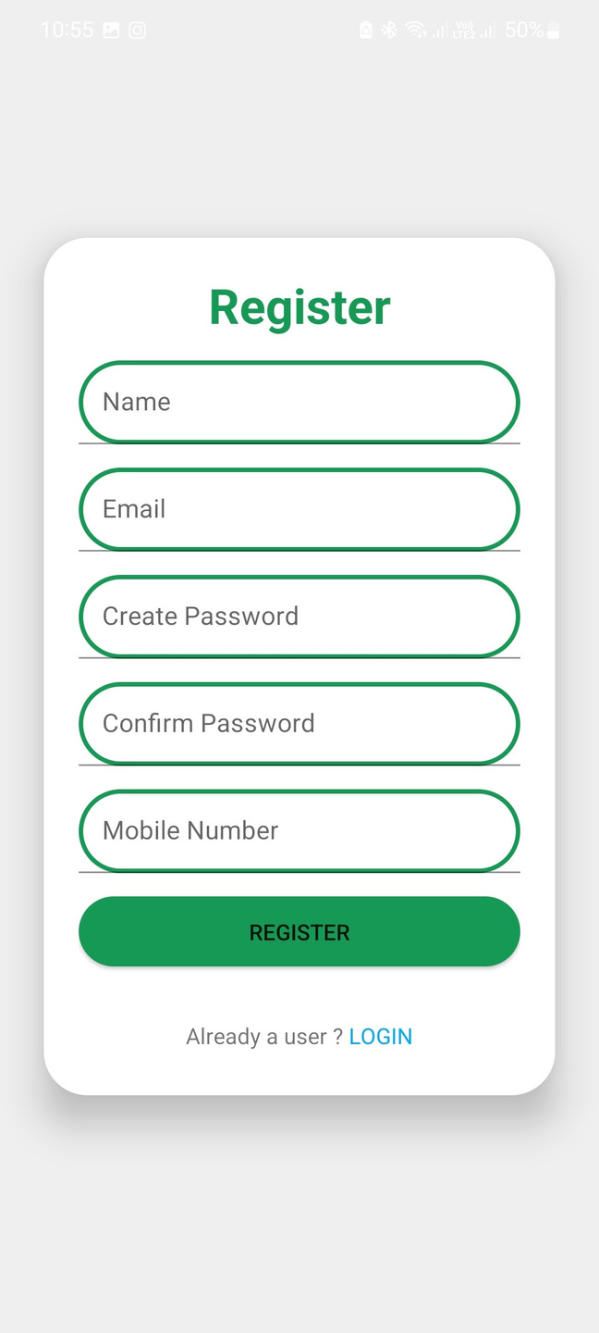
online shop
Menu
About Us
@reallygreatsite
Register Page
Fields Included:
Action Buttons:
Name: User's full name.
Email: For communication and account recovery.
Password: Secure password creation.
Confirm Password: Prevents typing errors.
Mobile Number: For contact and OTP verification.
Register: A green, clearly visible button to complete the process.
Login Link: A subtle link for existing users to sign in

Slide 5

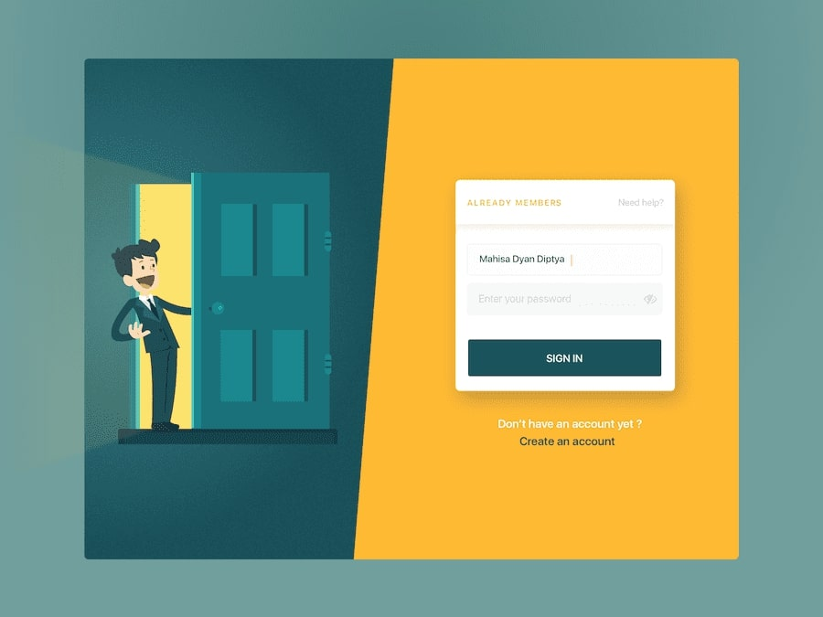
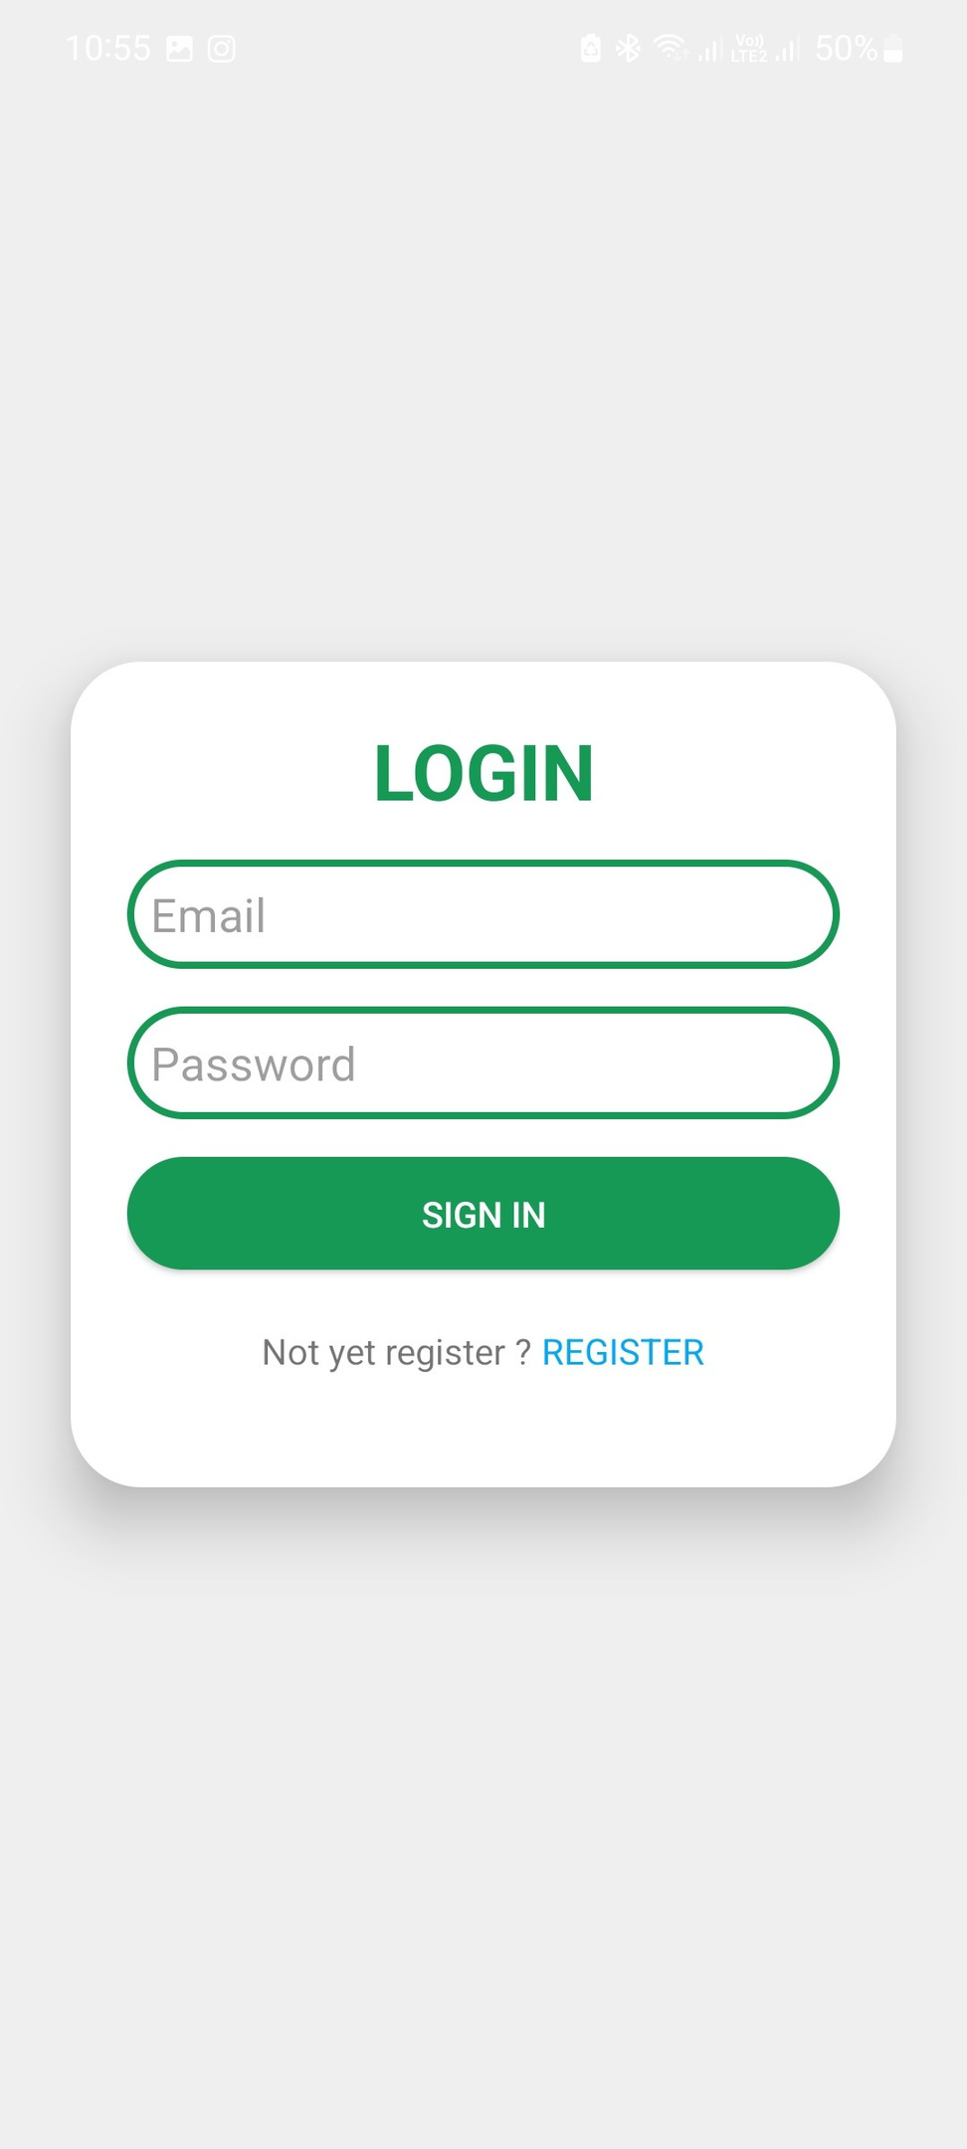


Login Page
Actionable Options:
My Reviews: View and manage product/service reviews.
Account Settings: Update account preferences and credentials.
Personal
Information: Edit personal details like name, address, etc.
Fingerprint Settings: Enhance security with biometric login options.
Log Out: Quick option to securely exit the account.
Action Buttons:
Sign In Button: Green, bold, and easily clickable for user login.
Support for New Users:
Text: “Not yet registered?”
A clickable Register Link redirects new users to the registration page.

Slide 6


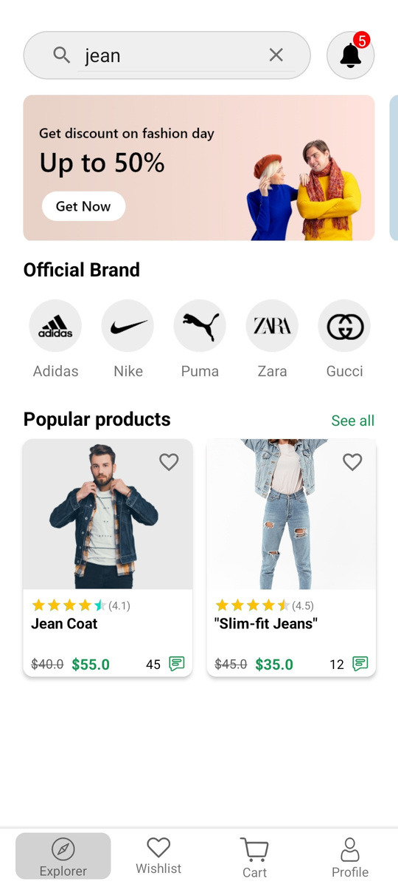
online shop
Search Your Product
The Search Option page allows users to quickly find products they are looking for in the app. It features a prominent search bar where users can type keywords or product names, with suggestions and autocomplete functionality to save time. Filters and sorting options are provided to narrow down results based on categories, price, ratings, or other preferences. The page also includes a history or trending searches section for easier navigation. Designed for efficiency and convenience, this page ensures users can explore the app’s catalog effortlessly and discover relevant products quickly.

Slide 7
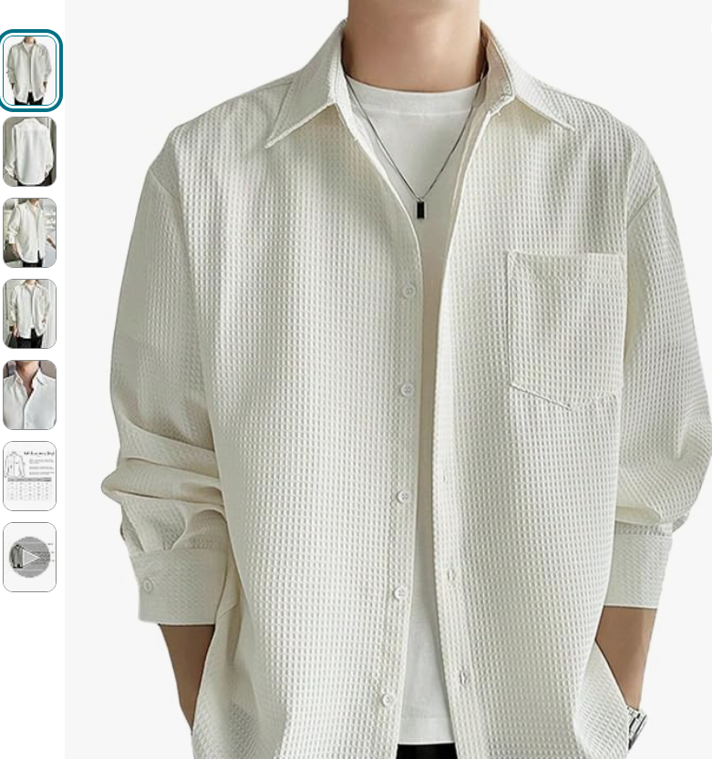

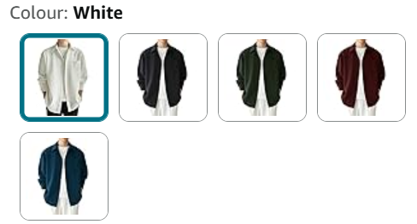
online shopping
product description
The product description tells you everything you need to know about the item, like its features, size, and how it can help you. It’s simple and clear, so you can easily decide if it’s right for you.
Multiple Photos
See the product from different angles with multiple photos. You can zoom in and check all the details to be sure of what you’re buying. It makes shopping easy and worry-free!

Slide 8
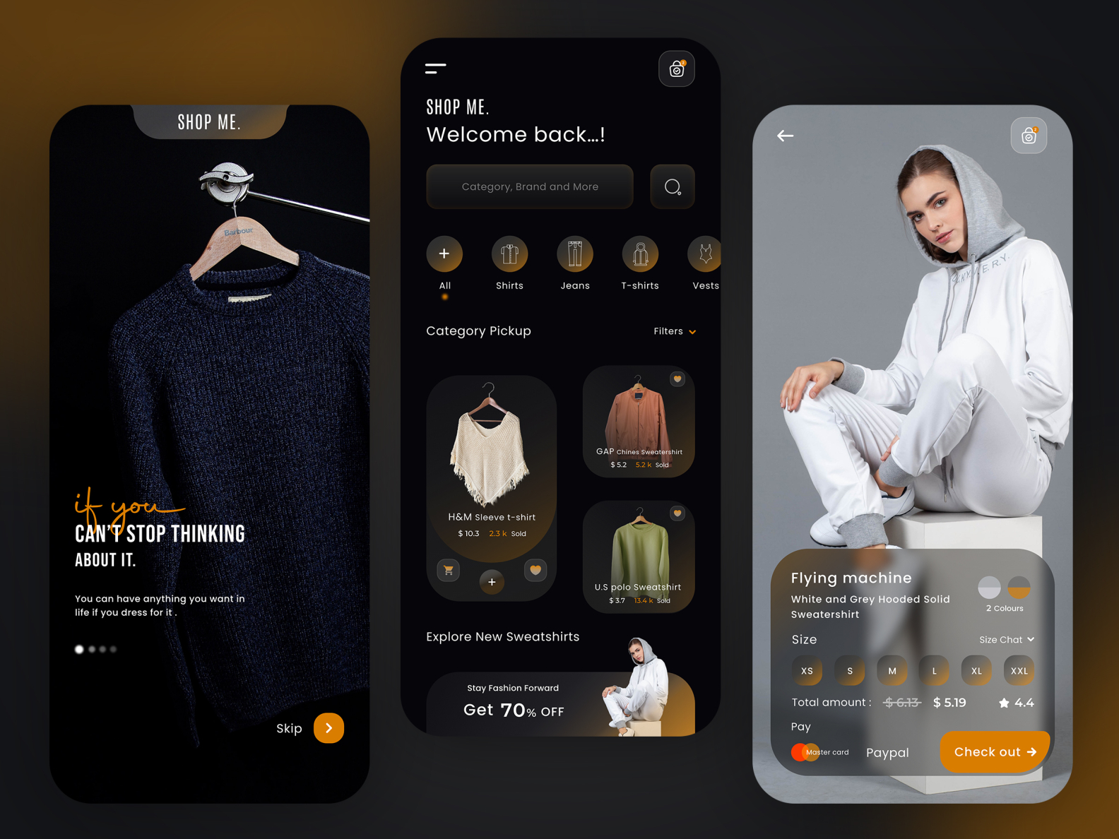
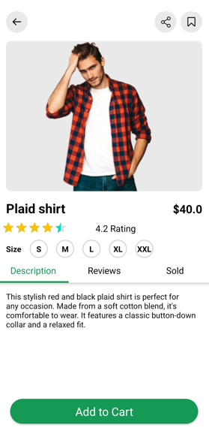
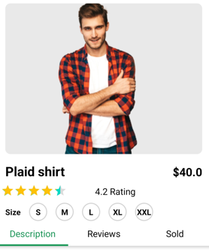

online shop
Menu
About Us
@reallygreatsite

Slide 9
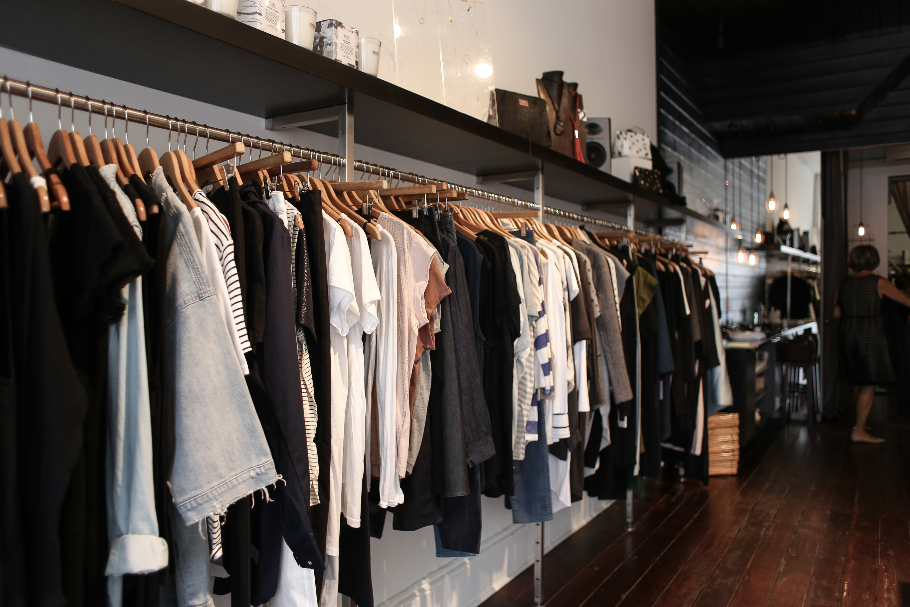
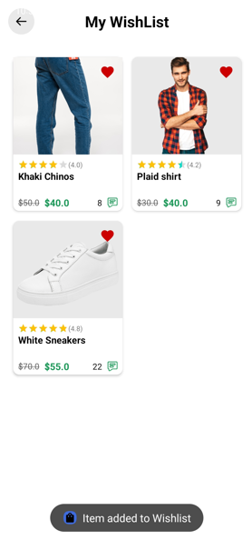
online shop
Menu
About Us
@reallygreatsite
WISHLIST
The Wishlist page is a place where you can save your favorite items to buy later. You can easily add products you like, check their prices, and see if they are in stock. It helps you keep track of everything you love in one place and notifies you about discounts or offers. Shopping made simple and convenient!
Save Favorites
Stay Updated
Easy Management

Slide 10
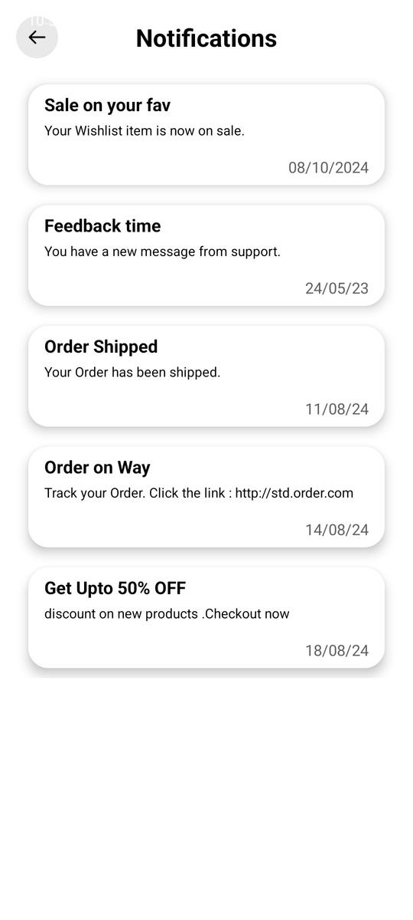
Online Shop
Menu
About Us
@onlineshop
Notification Page
The Notification page keeps users informed about their shopping activity and app updates. It displays important alerts like order status updates, delivery notifications, promotional offers, and personalized recommendations. Notifications are organized chronologically or into categories like "Orders," "Offers," or "Account Updates" for easy navigation. Users can also customize their notification preferences to control what they want to receive. This page ensures that users stay connected and updated, enhancing engagement and ensuring they never miss out on essential information or exciting deals.

Slide 11

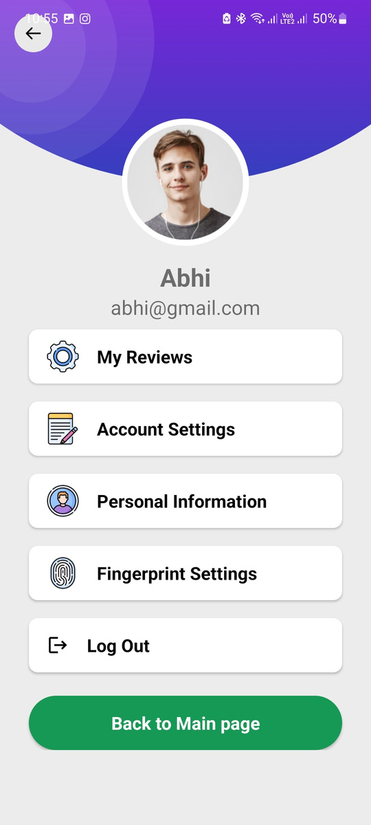
online shop
Menu
About Us
@reallygreatsite
Profile Settings Page
User Profile Section:
Profile Picture: Circular display of the user's image.
Name & Email: User's full name and registered email for identification.
Actionable Options:
My Reviews: View and manage product/service reviews.
Account Settings: Update account preferences and credentials.
Personal Information: Edit personal details like name, address, etc.
Fingerprint Settings: Enhance security with biometric login options.
Log Out: Quick option to securely exit the account.
Navigation Button:
Back to Main Page: A green, prominent button for easy return to the main dashboard.

Slide 12

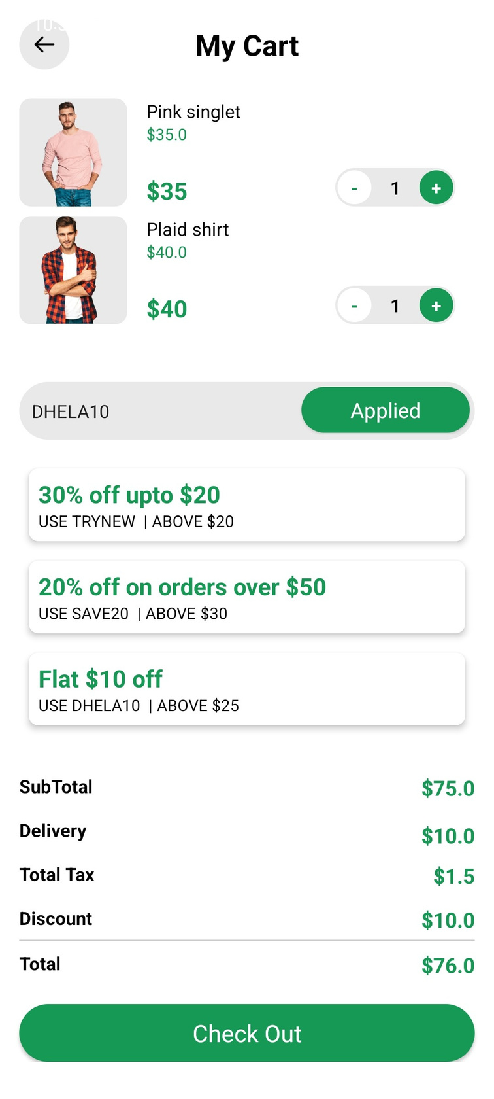
online shop
Checkout Cart
The Order Confirmation page ensures customers know their purchase was successful by displaying a clear thank-you message, order details, and an estimated delivery date. It reassures users by providing an order ID for reference and informing them about a confirmation email. Additionally, it includes a tracking option for real-time updates and a customer support link to address any concerns, creating a seamless and trustworthy post-purchase experience.

Slide 13

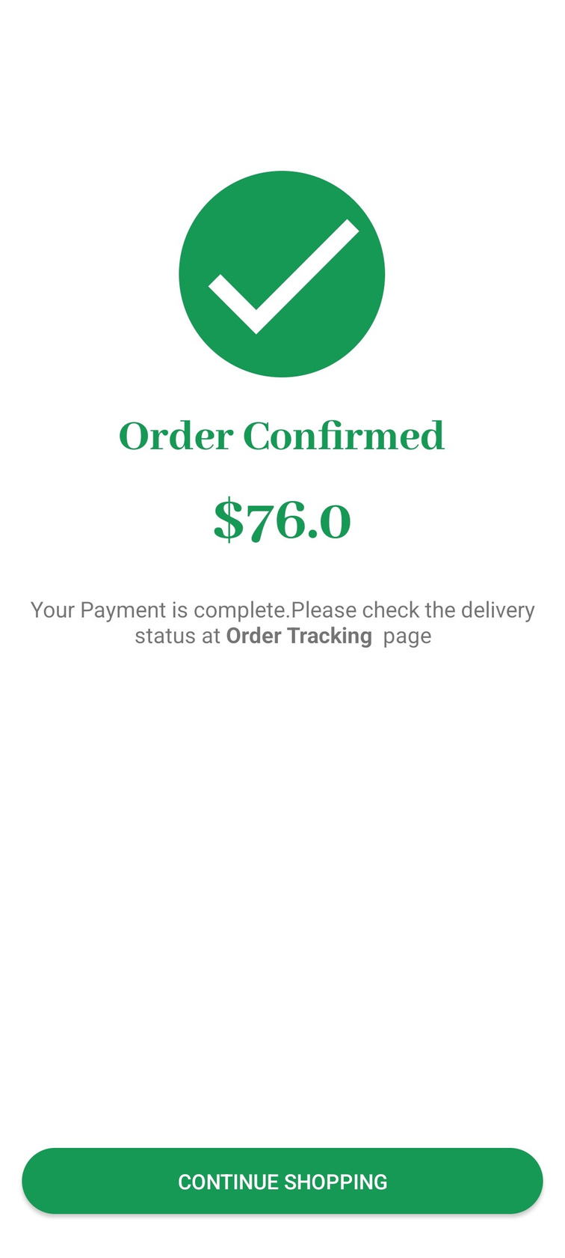
online shop
Confirmed Order
The Bill Confirmation page displays the total amount paid for the order, giving users a clear confirmation of the final price. It ensures transparency by summarizing the exact cost, including taxes and discounts, and provides reassurance that the payment was successful. This page serves as a simple acknowledgment of the completed transaction, with an option to save or share the billing details for future reference.

Slide 14




online shop
Menu
About Us
@onlineshop
Thank you
kiit University,Patia
+91 xxxxxxxxxx
www.onlineshop.com

